Slide 1
RIQAS user group meeting
Stephen Doherty – RIQAS Manager
Dr Sally Picton – RIQAS Deputy Manager

Slide 2

Errors occur in laboratories all over the world
2/3 of information used by physicians to make their diagnosis comes from laboratory testing
Consequences of wrong results can include:
  Repeated tests
  Misdiagnosis
  Inappropriate treatment
  All resulting in increased costs
  Patient care may be compromised
A lab with a quality system in place will still have errors but should detect them quicker therefore reducing their impact.

Slide 3
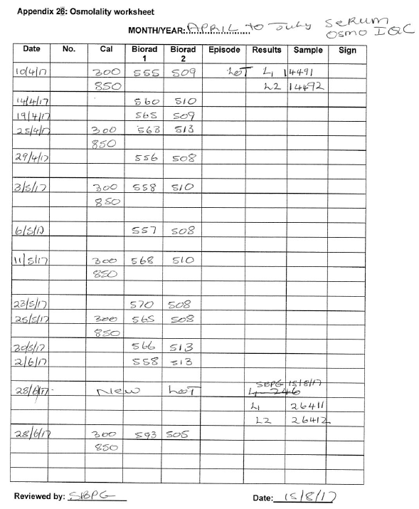
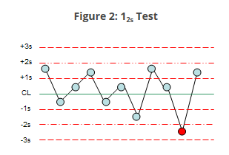
Why do we need a Quality Management Strategy
Quality in the Medical Laboratory is evolving
Laboratory Quality Control has moved from the one dimensional view of
“ if it is within the range…….”
To the 2-dimensional Levey Jennings Chart
with SD, CV and Westgard Rules.

Slide 4
BUT Laboratory Quality is not 2 dimensional,
it is multi-faceted
Although laboratory Quality is primarily based on SD or CV, if you look at it from different perspectives, you will get a different picture and notice aspects that you may have missed.
No longer look at Quality Control but Quality Management and to do this you need a good QC management tool
Every different facet of our Quality system is giving us different valuable information – IQC, EQA etc.
.

Slide 5
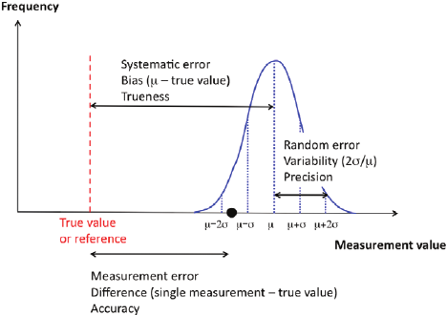

Slide 6
Total Error
Total Error (TE) or Total Analytical Error (TAE) represents the overall error in a test result that is attributed to imprecision (%CV) and inaccuracy (%Bias), it is the combination of both random and systematic errors
TE = %BIAS + (1.96 * %CV)

Slide 7
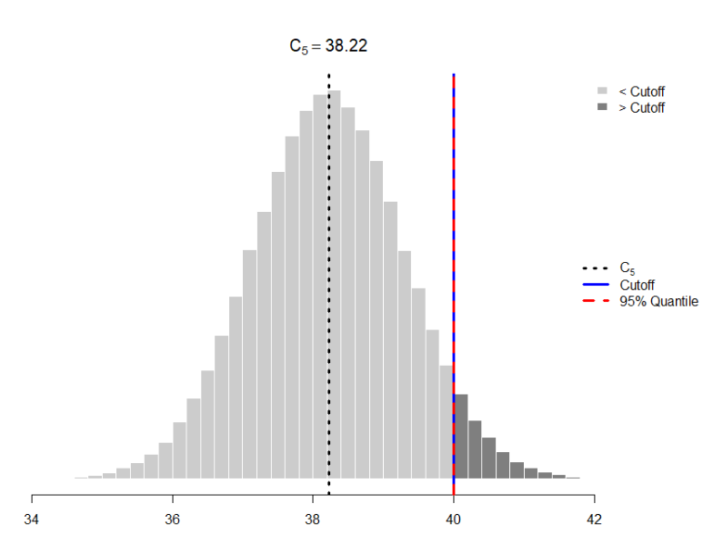

Slide 8
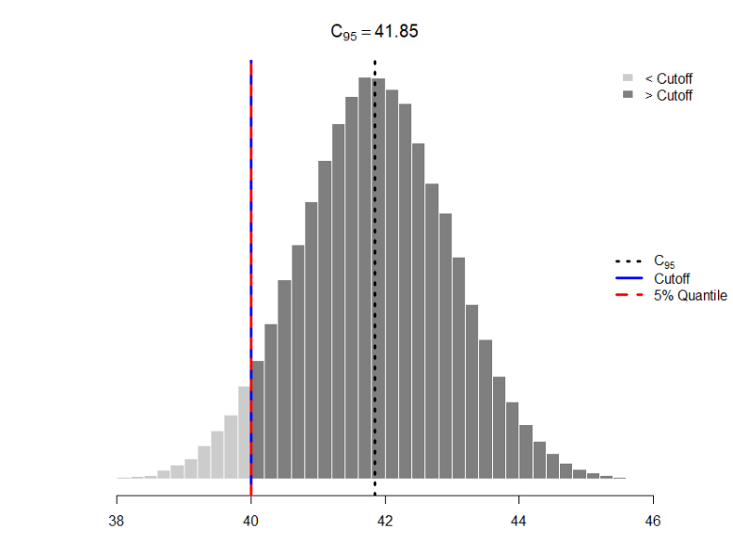

Slide 9
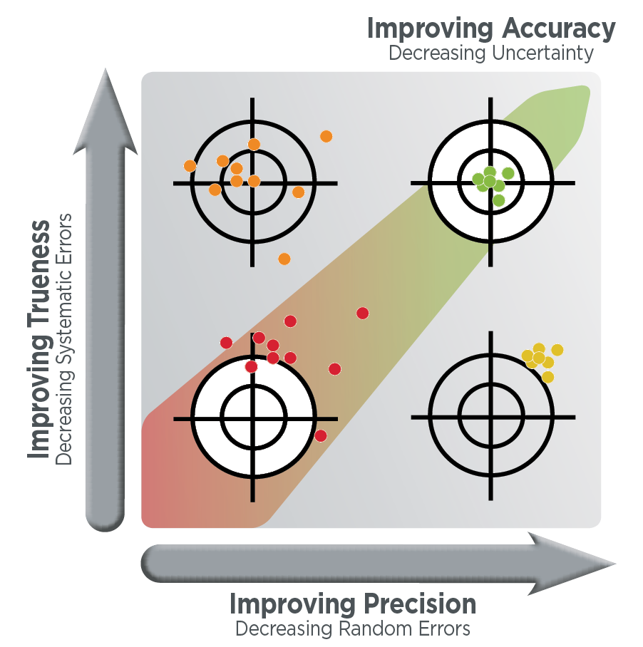

Slide 10
Report Interpretation
Participation in an EQA programme itself does not lead to an improvement in quality of analytical performance
EQA results must also be interpreted and understood
  Require conclusions
  Corrective actions
  Check the effectiveness of the corrective actions
Notes:
External Quality Assessment (EQA) is an important educational tool that allows laboratories to monitor, evaluate and improve their analytical performance.
Participation in an EQA scheme alone however is not sufficient and will not lead to improved quality or performance. In fact it is of limited value unless the laboratory learns to effectively interpret and understand their EQA results.
The ability to understand your EQA report maximizes the benefits of participating in an EQA scheme like RIQAS.

Slide 11
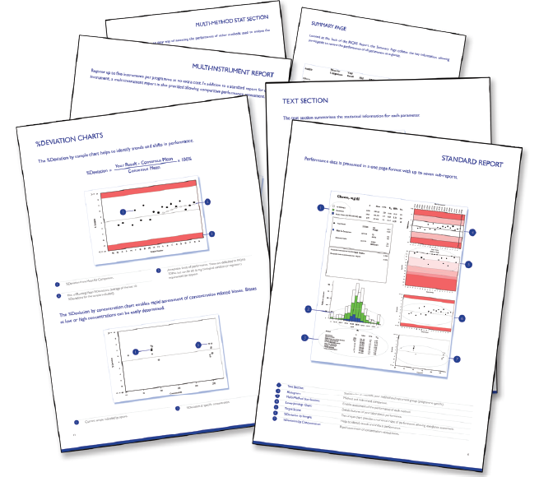
Much of the value of an EQA programme lies in the report that the laboratory receives
The report needs to be comprehensive, providing the laboratory with valuable information on their performance, yet easy and quick to interpret
It is important that the data is simple to understand, so that laboratories can quickly identify tests that require performance improvement measures

Slide 12

Understanding Quantitative Reports

Slide 13
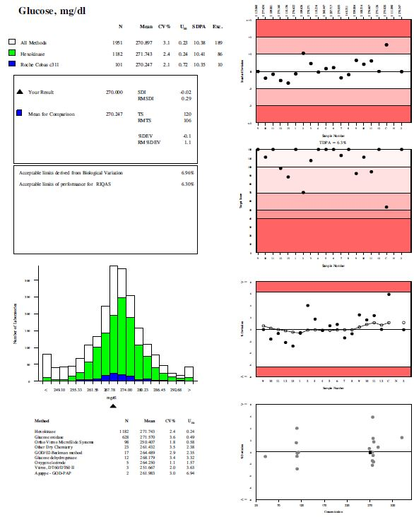
Up to seven sub-reports are displayed, providing a variety of performance indicators and comparisons to allow easy interpretation

Slide 14
Text Section:
Contains all the statistical information

Slide 15
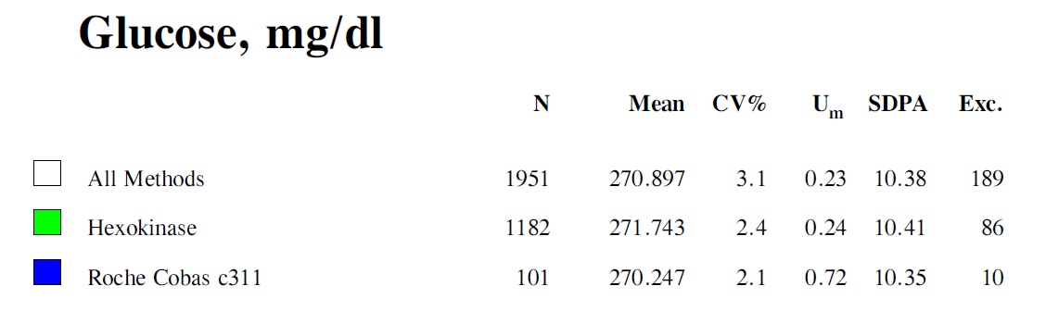
Statistical summary based on your assay details
Results are reported in the lab’s own unit
A breakdown of the means at each of the lab’s peer group levels is shown:
All Methods
The lab’s selected method
The lab’s selected instrument (within the method peer group)

Slide 16
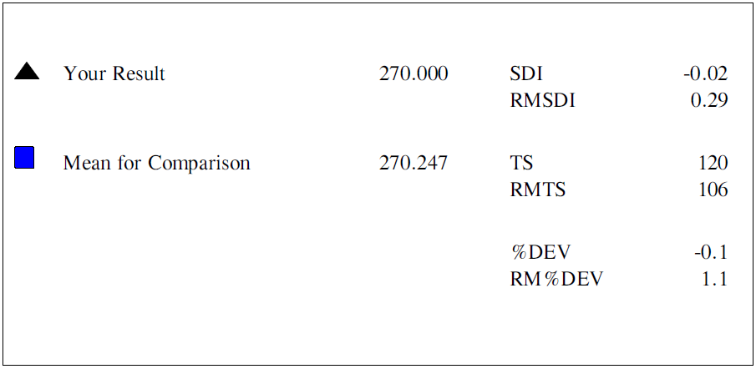
‘Your result’ section
We show the 3 performance indicators – SDI, % Deviation and Target Score
SDI calculated using SDPA_{adjusted}
TS calculated using TDPA

Slide 17
‘Your result’ section
Running Means – average of last 10 SDI, TS and %Dev
Good to trend performance over a period of time, over the full range of concentrations
! RMSDI and RM%Dev may average out performance issues (because SDI and %Dev have a sign)
RMTS gives a good all round indication of performance
(TS has no sign)

Slide 18
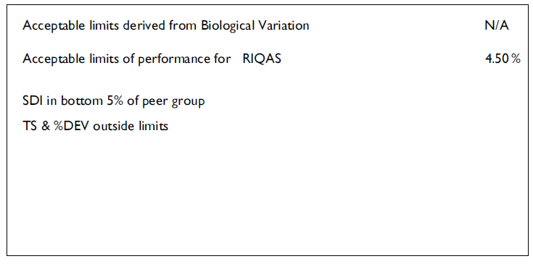
Acceptable limits/performance status
Biological variation is not currently being displayed due to changes in how it is being calculated
Acceptable limits defaulted to RIQAS TDPA
  can be changed to official criteria defined by governing bodies, or country-specific requirements (e.g. CLIA’88 or Biological Variation) on request
Poor performance is flagged

Slide 19
Histogram:
Provides a method
and instrument
comparison

Slide 20
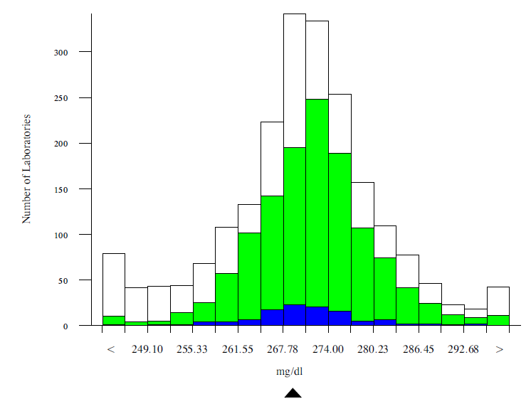
Histogram
The histogram shows a breakdown of all the results that have been returned for this sample.

Slide 21
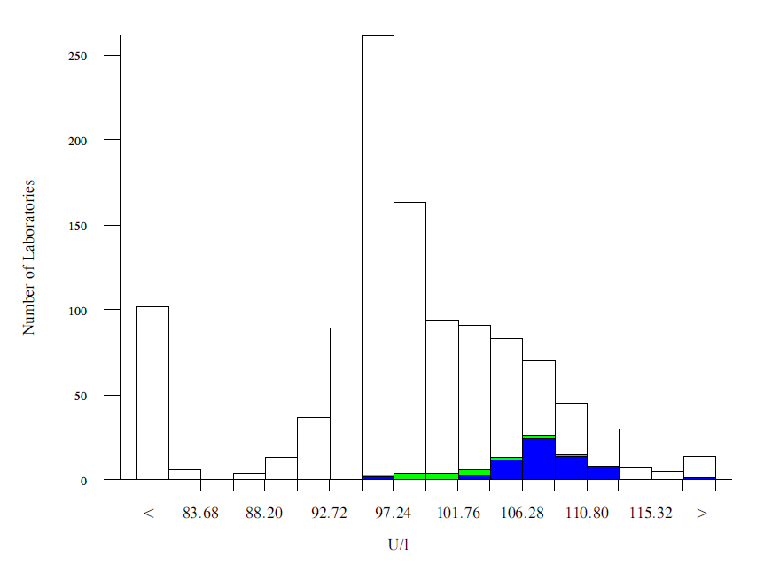
The histogram can be used to show if the method or instrument has any kind of a bias
Here you can see the method and instrument results have a positive bias compared to the All method results.

Slide 22
Multi Method Stat Section:
Enables assessment of the performance of each method

Slide 23
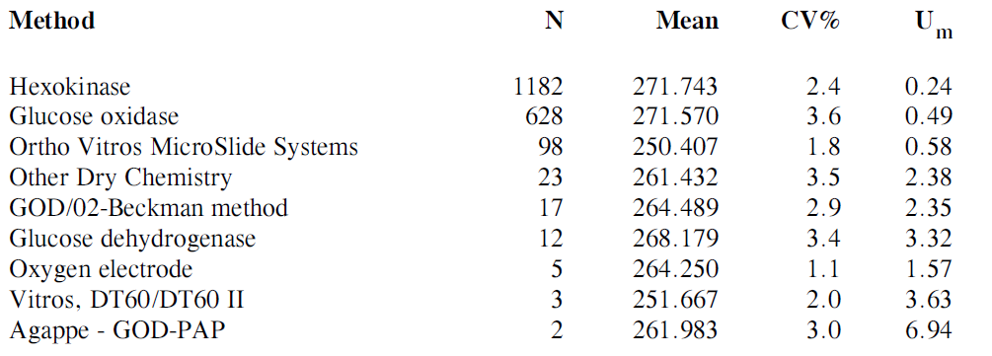
Method summary
Uncertainty (U_{m}) stated for each method
CV = calculated SD x 100
mean for comparison

Slide 24
Levey Jennings Chart:
Shows performance with time

Slide 25
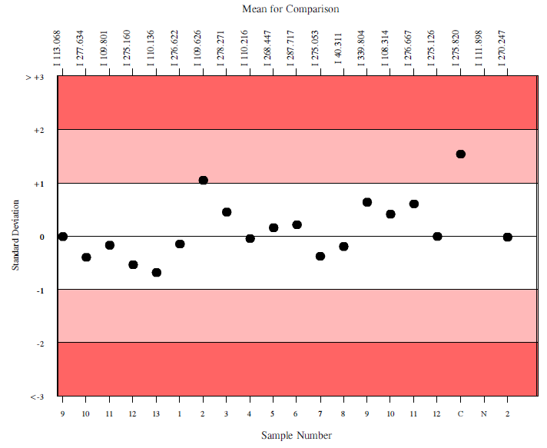
Levey-Jennings Chart
Means for Comparison for previous samples are stated across the top including the level of comparison
Current result
Plots SDIs of 20 most recent samples
Acceptable performance SDI < 2

Slide 26
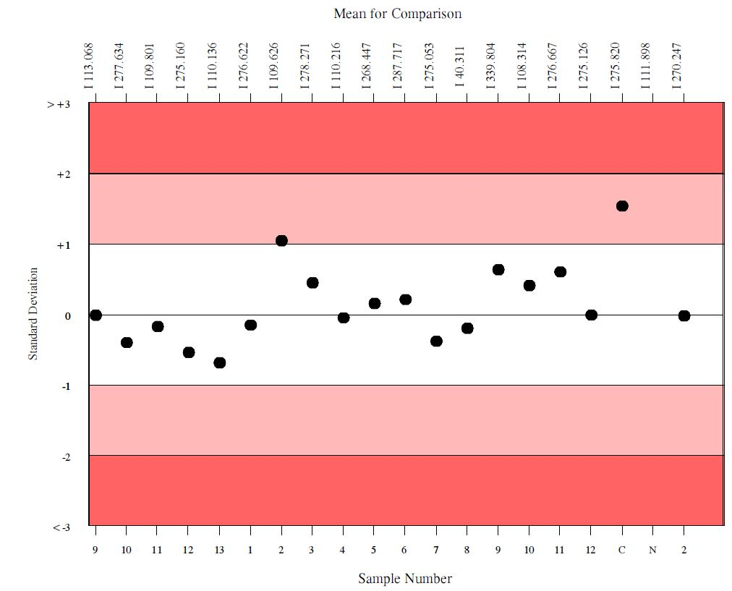
3 SD limits
Shading indicates performance - lighter the shading, the more accurate the results
Sample numbers are stated
If any results are corrected or no result is returned this is shown instead of the number
Acceptable performance is
SDI<2

Slide 27
Target Scoring Chart:
Provides a visualisation of a laboratory’s Target Scores

Slide 28
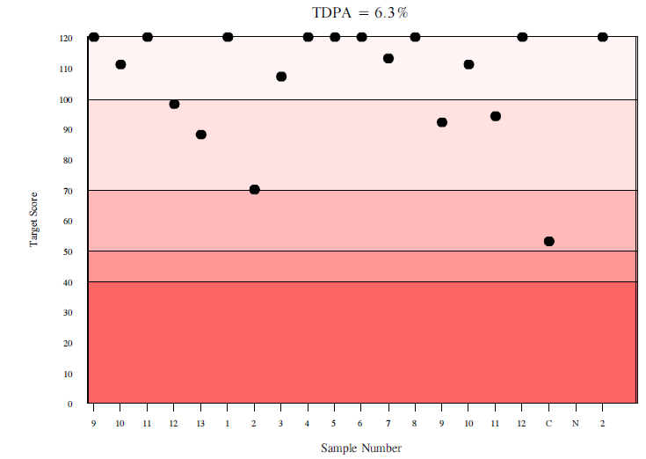
Target Scoring chart
Target Deviation for Performance Assessment – different for each parameter
Current result
Excellent
Good
Acceptable
Need For Improvement
Unacceptable
Plots last 20 Target Scores
Acceptable Performance is TS > 50

Slide 29
% Deviation by Sample Chart:
Helps to identify trends and shifts in performance

Slide 30
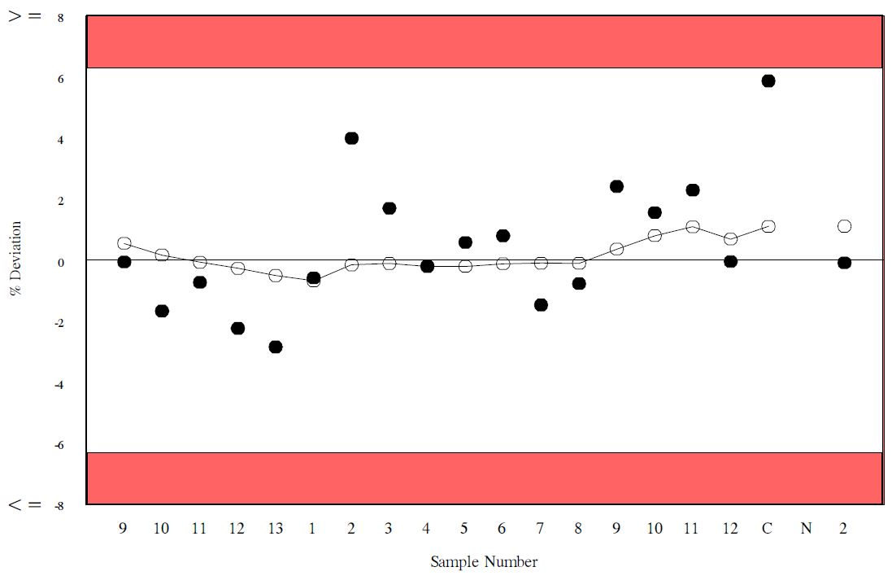
Percentage deviation by sample
Plots %Dev for last 20 samples
Acceptable limits defaulted to RIQAS TDPA
can be changed to official criteria defined by governing bodies, or country-specific requirements (e.g. CLIA’88 or Biological Variation) on request

Slide 31
Percentage deviation by sample
*
All results in white section are within the acceptable limits for this parameter
*Any results in red section are outside the acceptable limits for this parameter
*
% Deviation scale can change for each parameter

Slide 32
Percentage deviation by sample
Running mean %Deviation – average of last 10 %Dev
Look for trends over a period of time
Indication of performance over full range of concentrations

Slide 33
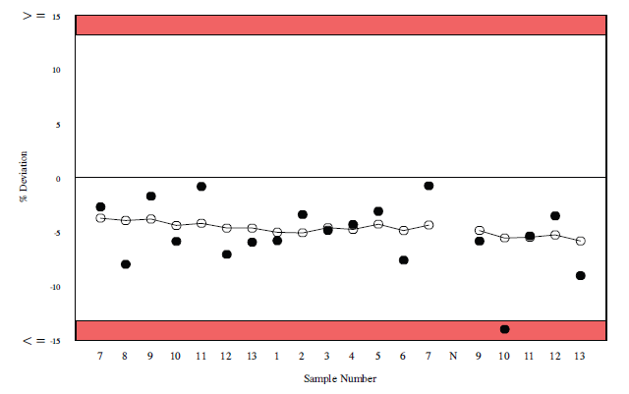
Percentage deviation by sample
Running mean %Deviation
A good indication of overall performance (when all the results are on the same side of zero)
Indication of potential systematic error

Slide 34
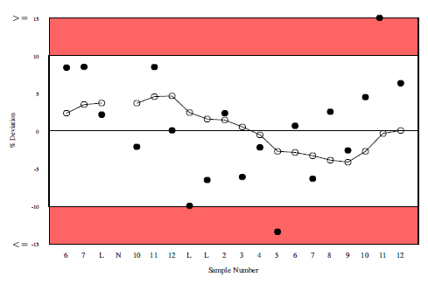
Percentage deviation by sample
Running mean %Deviation
Difficult to interpret RM%Dev when results are both positive and negative.
RMTS is a better indicator, in this case

Slide 35
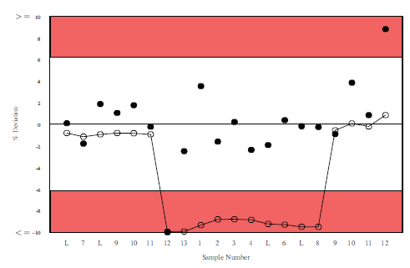
Percentage deviation by sample
Running mean %Deviation
Running Performance “suffers” for 10 samples because of 1 bad result

Slide 36
% Deviation by Concentration Chart:
Provides a rapid assessment of concentration related biases

Slide 37
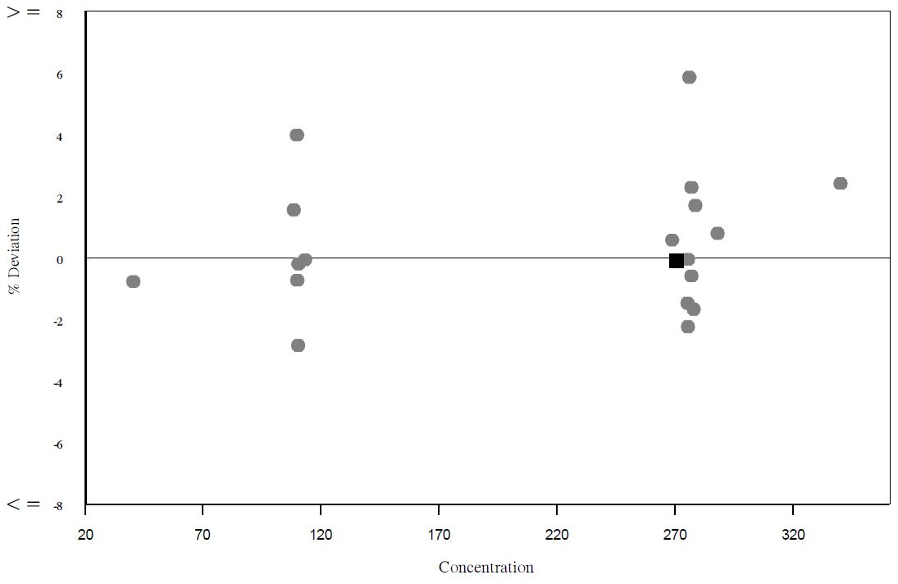
Percentage deviation by concentration chart
Current result indicated by black square
Previous 20 results at the same comparison level
Look for concentration related biases

Slide 38
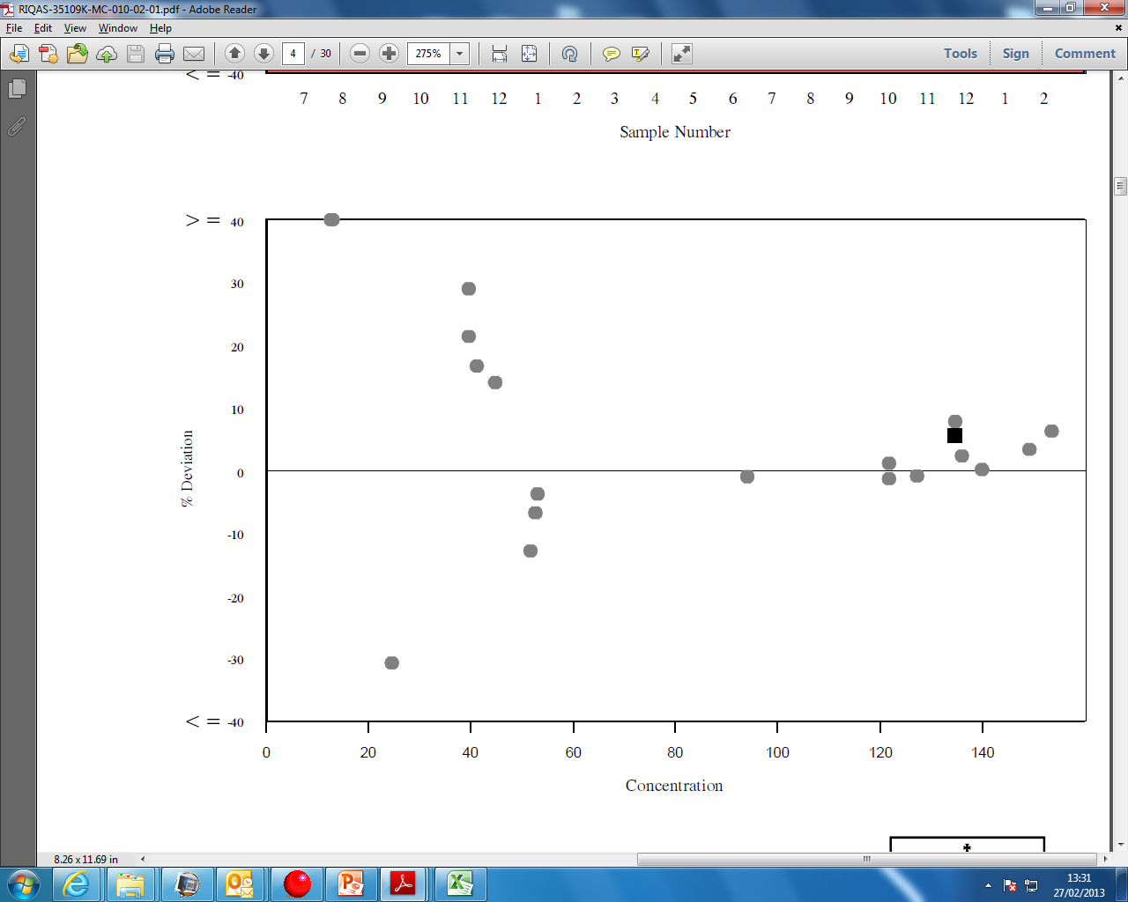
Percentage deviation by concentration chart
Lab’s performance good at high concentrations. Quite varied at low concentrations.

Slide 39
Percentage deviation by concentration chart
Lab’s performance good at low concentrations. Positive bias at higher concentrations.

Slide 40
Essentials of ISO:17043
Statistical design
  Fit-for-purpose performance evaluation intervals
  Known aspects of variability in samples
  Fit-for-purpose assigned values
    Appropriate handling of gross outliers
    Appropriate handling of statistical outliers
    Robust statistics to calculate consensus means for comparison
      Uncertainty of assigned value

Slide 41
How are the 3 RIQAS performance indicators calculated?

Slide 42
RIQAS Performance Indicators
% Dev SDI TS
Difference between your result and a “target” or “assigned value”

Slide 43
RIQAS Performance Indicators
%Dev – your bias relative to the mean
Target Score – Your % deviation relative to a target deviation (TDPA)
- TDPA is the evaluation interval
SDI – your bias relative to the SDPA
- SDPA is evaluation interval

Slide 44
SDI
SDI = Your Result - Mean For Comparison
SDPA
% Deviation
% Dev = Your Result - Mean For Comparison
Mean for Comparison
x100

Slide 45
Target Score
TS = log₁₀ 3.16 x TDPA x 100
%Dev
Where: TDPA = Target Deviation for Performance Assessment(%)
%Dev = Your deviation from the mean for comparison (%)
%Dev = (Your result - Mean for Comparison) x 100
Mean for Comparison
%Dev = TDPA, TS = 50
%Dev > TDPA, TS < 50
%Dev < TDPA, TS > 50

Slide 46
Acceptable performance:
SDI should be less than 2
TS should be greater than 50
% deviation should be less than acceptable limits (RIQAS TDPA, BV, CLIA, National etc.)

Slide 47
Essentials of ISO:17043
Statistical design
  Fit-for-purpose performance evaluation intervals
  Known aspects of variability in samples
  Fit-for-purpose assigned values
    Appropriate handling of gross outliers
    Appropriate handling of statistical outliers
    Robust statistics to calculate consensus means for comparison
      Uncertainty of assigned value

Slide 48
TDPAs (Target Deviations for Performance Assessment) are set for each individual parameter
TDPAs take account of potential variability in samples through testing of:
  Homogeneity
  Reconstituted stability
  Real time stability
  Shipping/transport stability

Slide 49
Assigning TDPAs
To ensure that TDPAs take account of any sample variability, our software selects the largest of
Calculated Target Deviation
  Assigned looking at historical performance of labs, set so that ~10% labs achieve poor performance (TS<50)
Test homogeneity x 3.33
Test stability x 3.33
Transport difference x 3.33
WHY? ….. IUPAC clause:
Sample variability < 30% the evaluation interval
OR
Evaluation interval > 3.33 x sample variability

Slide 50
Only 2% of parameters need to be adjusted due to sample variability
  Excellent materials
  TDPAs can be generally based on the calculated Target Deviations

Slide 51
Using TDPA to calculate Target Score
TS = log₁₀ 3.16 x TDPA x 100
%Dev
Where: TDPA = Target Deviation for Performance Assessment(%)
%Dev = Your deviation from the mean for comparison (%)
%Dev = (Your result - Mean for Comparison) x 100
Mean for Comparison
%Dev = TDPA, TS = 50
%Dev > TDPA, TS < 50
%Dev < TDPA, TS > 50

Slide 52
RIQAS Evaluation Intervals:
TDPA SDPA
For every parameter
  1 TDPA
    Same for all samples and concentrations
    Will only change annually
  Different SDPAs for different samples
    SDPA will change depending on the concentration (mean for comparison)

Slide 53
Using TDPA to calculate SDPA
SDPA = TDPA x Mean for Comparison
t-value x 100
t-value = factor which represents the % of poor performers reflected in the TDPA
(t-value ~ 1.645 when ~10% laboratories achieve poor performance)

Slide 54
Essentials of ISO 17043
Statistical design
  Fit-for-purpose performance evaluation intervals
  Known aspects of variability in samples
  Fit-for-purpose assigned values
    Appropriate handling of gross outliers
    Appropriate handling of statistical outliers
    Robust statistics to calculate consensus means for comparison
      Uncertainty of assigned value

Slide 55
Removal and Reporting of Gross Outliers
Gross Outliers identified using approved methods
Marked as “DE-ACTIVATED”
De-activated results are not used to generate statistics
De-activated results are stated on reports

Slide 56
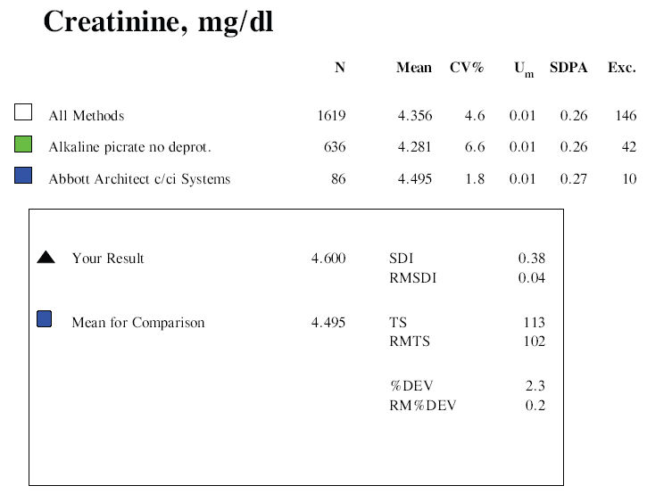
These are highlighted on the report as exclusions, and generally represent about 5 -10% of results

Slide 57
Essentials of ISO:17043
Statistical design
  Fit-for-purpose performance evaluation intervals
  Known aspects of variability in samples
  Fit-for-purpose assigned values
    Appropriate handling of gross outliers
    Appropriate handling of statistical outliers
    Robust statistics to calculate consensus means for comparison
      Uncertainty of assigned value

Slide 58

Confidence in assigned value
“4.4.5.4 When a consensus value is used as the assigned value, the proficiency testing provider shall document the reason for that selection and shall estimate the uncertainty of the assigned value as described in the plan for the proficiency testing scheme."

Slide 59
RIQAS: Confidence in assigned value
The uncertainty (u_{m}) associated with each mean for comparison is:
U_{m} = 1.25 x SD must be < 0.3 SDPA
√ n
where SD is the calculated SD from the consensus of results

Slide 60
RIQAS: Confidence in assigned value
Each SDPA is compared to the calculated U_{m}
If u_{m} is greater than 0.3 x SDPA, it is considered to be significant and needs to be combined with SDPA, as follows:
SDPA_{adjusted} = √ u_{m}² + SDPA²

Slide 61
RIQAS: Confidence in assigned value
If u_{m} is less than 0.3 x SDPA, it is considered to be insignificant and
SDPA_{adjusted} = SDPA

Slide 62
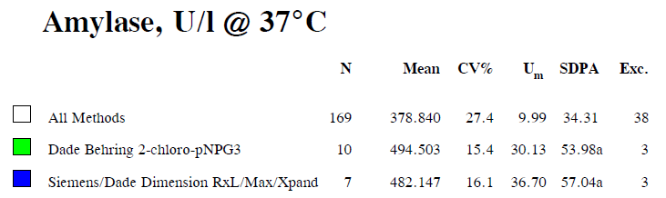
Uncertainty of assigned value presented with all means for comparison
If uncertainty is significantly large, it is combined with SDPA, and marked “a”

Slide 63
Using SDPA_{adjusted} to calculate SDI
SDI = participant’s result – MFC
SDPA_{adjusted}
SDI performance closely mirrors Target Score performance since SDPA is directly related to TDPA

Slide 64
‘Your result’ section
We show the 3 performance indicators – SDI, % Deviation and Target Score
SDI calculated using SDPA_{adjusted}
TS calculated using TDPA

Slide 65
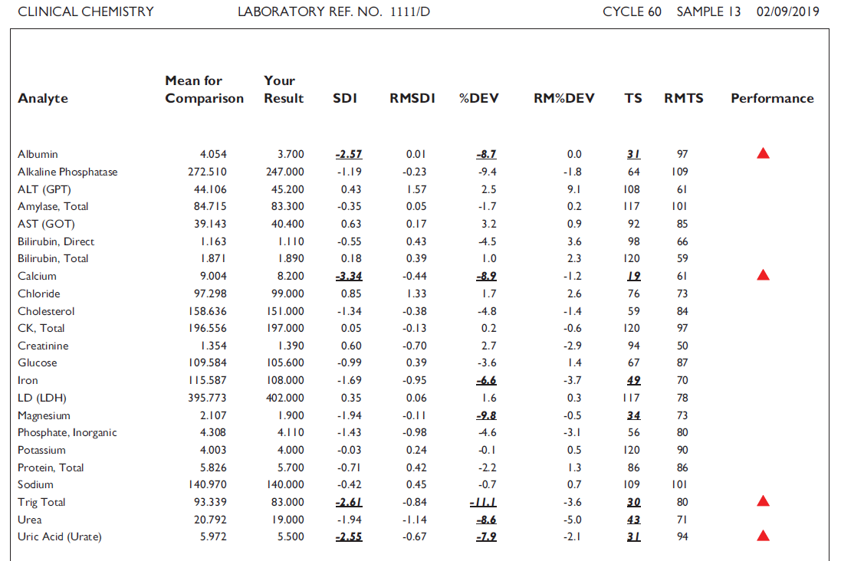
Summary Page
The summary page give an overview of the performance for all parameters for the current sample.

Slide 66
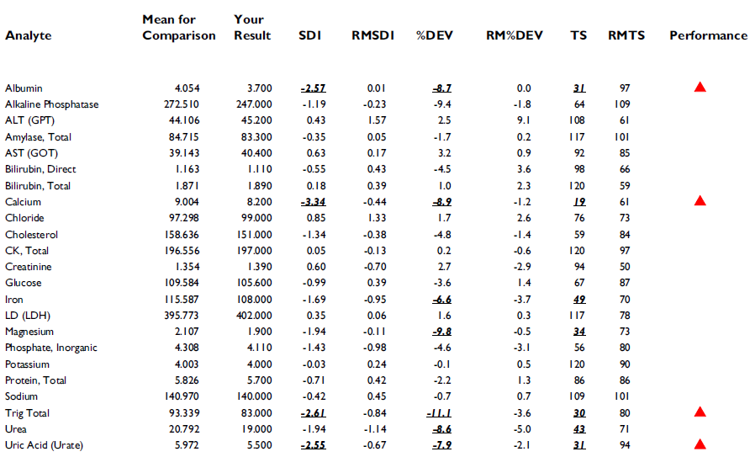
The 3 performance indicators and the running means for each indicator are listed

Slide 67
Poor performance for all 3 performance indicators are indicated by a red triangle on the summary page of the report

Slide 68
Instrument and Inter-laboratory summary reports
Summary in pdf format

Slide 69
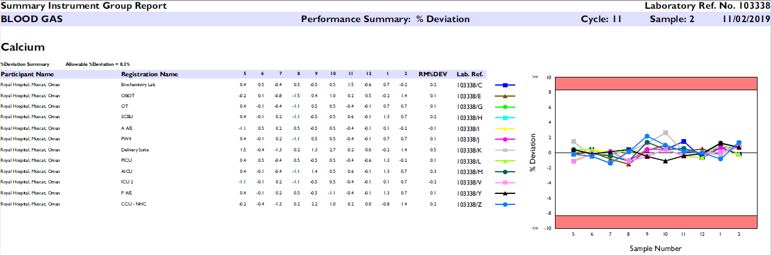
Summary report

Slide 70
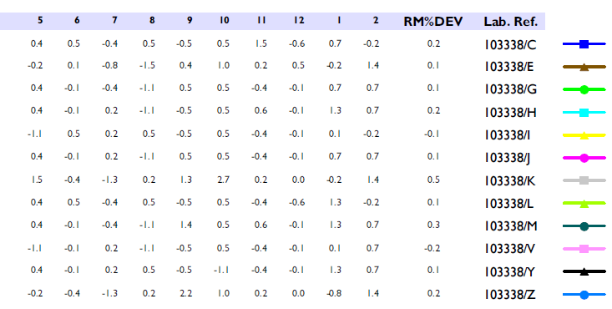
Current and historical %dev
9 previous samples
Current sample

Slide 71
Instrument and Inter-laboratory summary reports
Summary in csv format

Slide 72
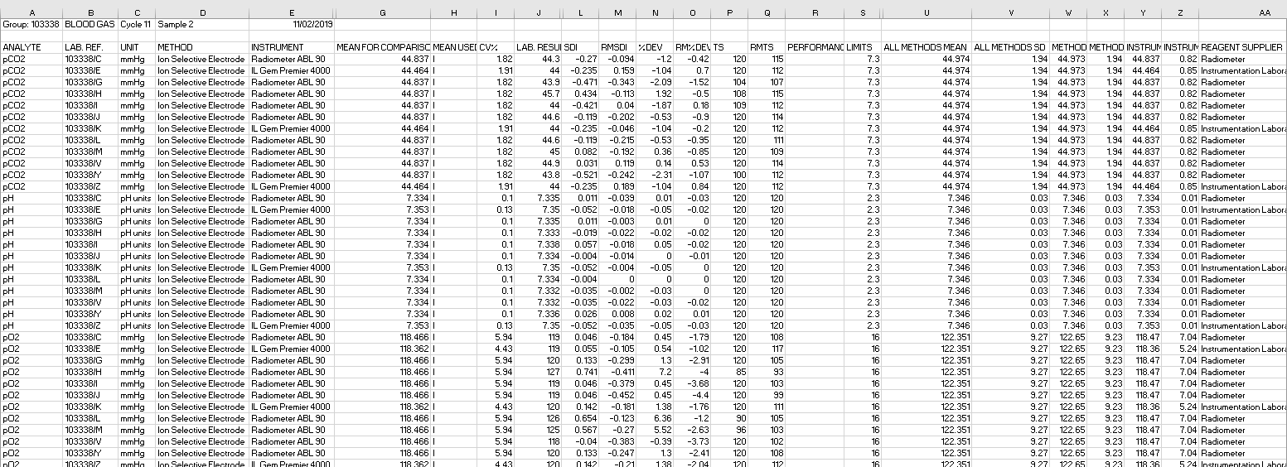
Group csv files information for current sample only

Slide 73
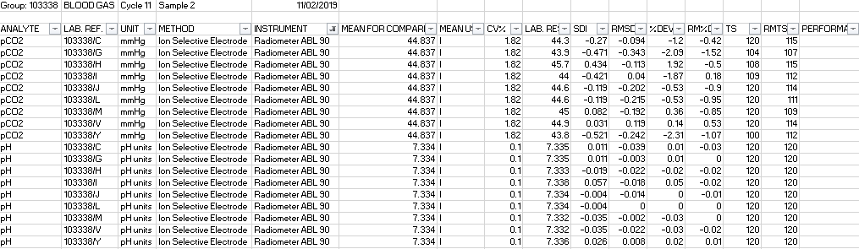
Add filter – filter by inst?

Slide 74
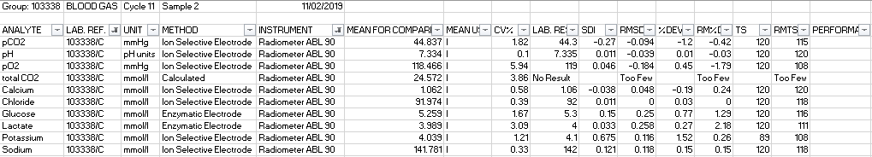
Add filter – filter by reg?

Slide 75
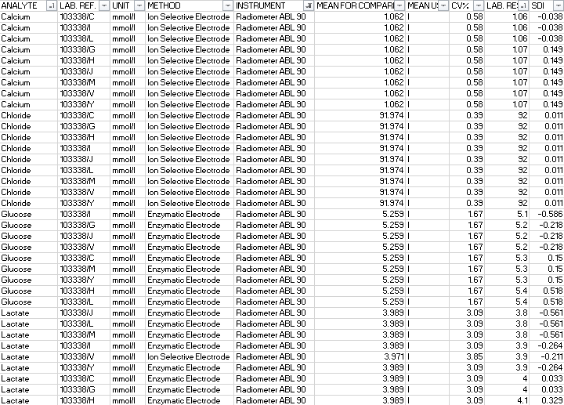
Sort by parameter and result

Slide 76
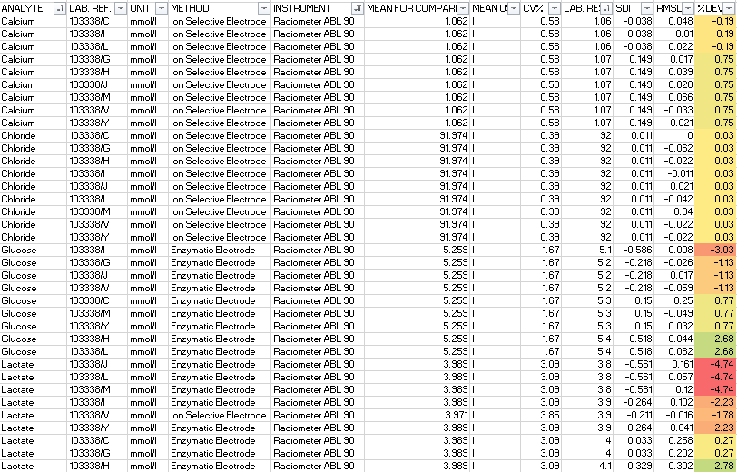
Add conditional formatting

Slide 77
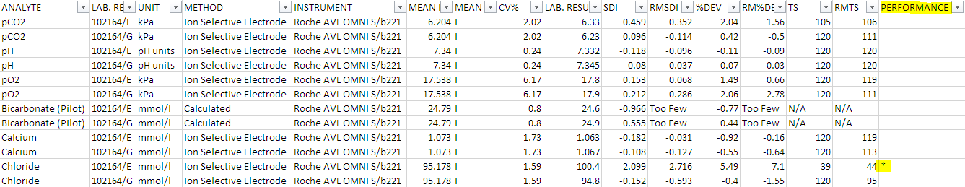
Filter for poor performance
‘*’ displayed in performance column represents on reports

Slide 78

End of Cycle Reports
(Standard quantitative programmes)

Slide 79
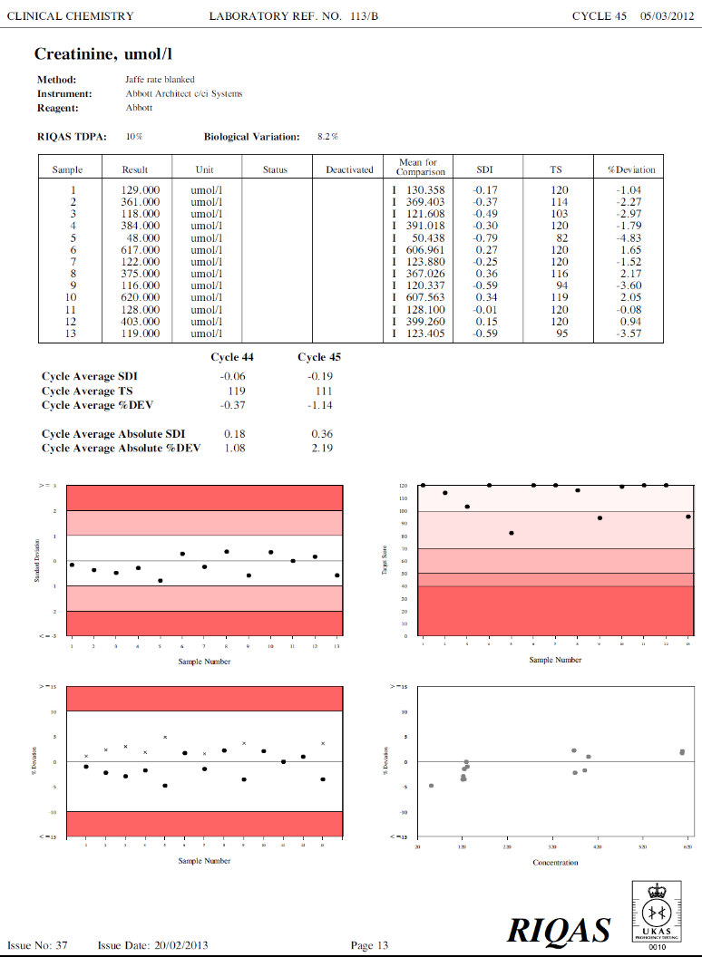
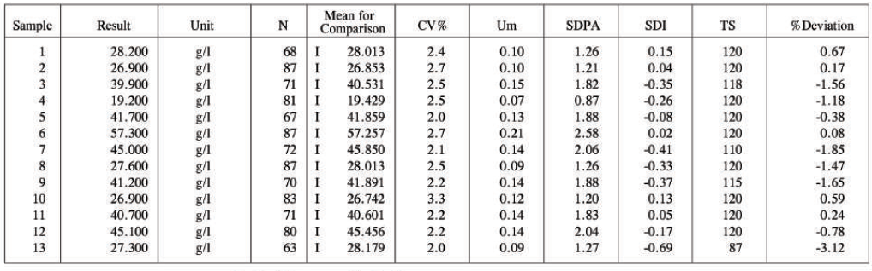
End of cycle report
Parameter page - 3 main sections
  Summary of submitted results
  Cycle based statistics
  Cycle based charts

Slide 80
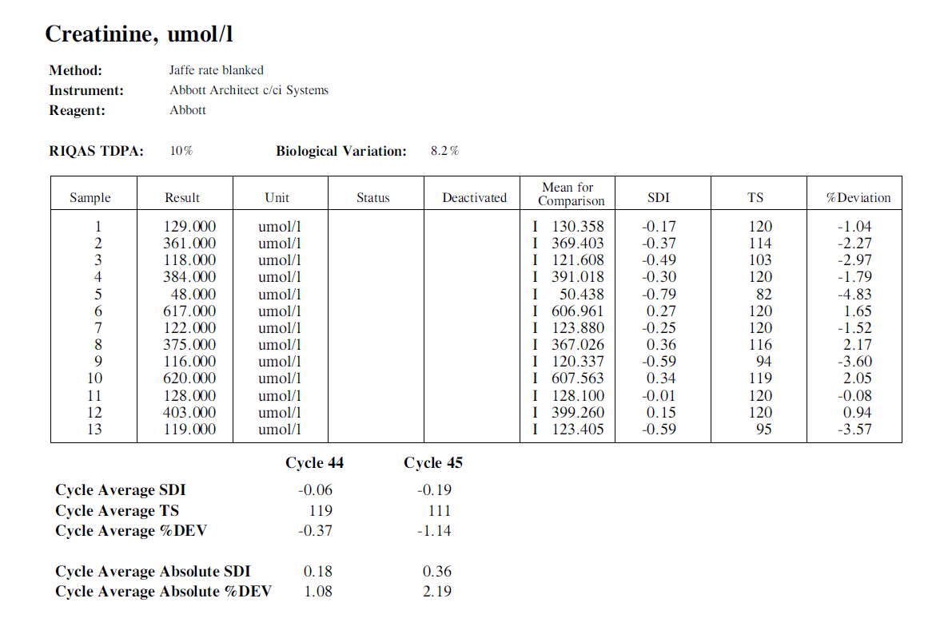
End of cycle report
Summary of submitted results
Cycle based statistics
Absolute scores look at magnitude of value and not sign

Slide 81
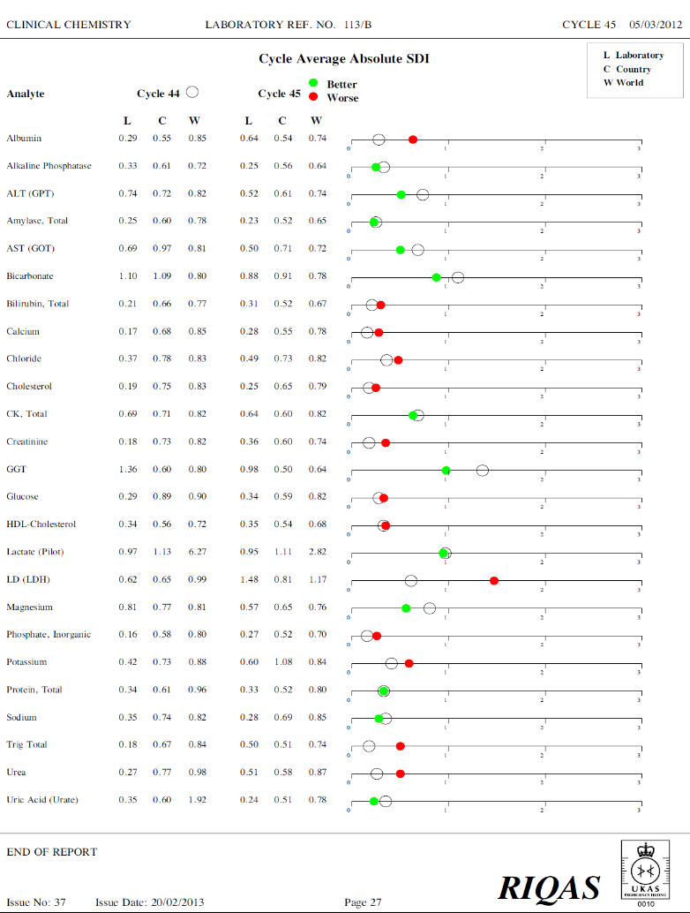
End of cycle – performance overview
Provides a graphical presentation of performance based on cycle average absolute SDIs
Laboratory, Country and World averages for the current and previous cycle

Slide 82
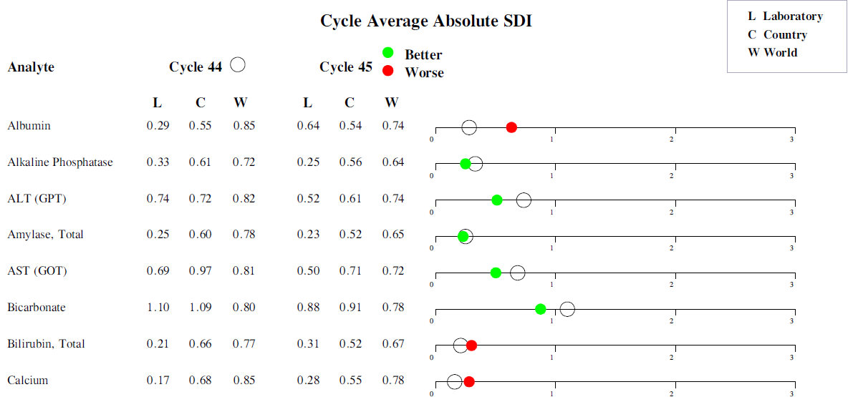
End of cycle – performance overview
Based on laboratory performance compared with last cycle

Slide 83
Time for a quick break to stretch your legs and get a drink.
We’ll start back in about 10 minutes.

Slide 84
How do I interpret my report and what do I do with the information?

Slide 85
I have just received my RIQAS report
  What is the first thing I should do?
If I look at the summary page of my report I can see the performance of all my parameters.

Slide 86
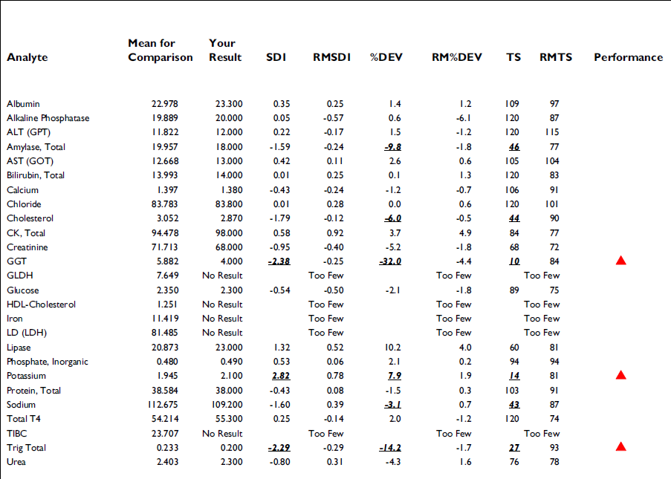

Slide 87
Which parameter/parameters have the worst performance?

Slide 88
If all 3 performance indicators fail the red triangle marks the spot - these are the parameters whose performance we need to investigate first – GGT, Potassium and Trig Total

Slide 89
If we look at the performance for GGT, Potassium and Trig Total – we can see that over the 3 performance indicators GGT has the worst performance

Slide 90
You can see there are some other parameters that have failed some of the performance indicators – these are still bold and underlined but there is no triangle as not all 3 failed.
These should also be looked at.

Slide 91
The running means can be used to give an indication of long-term performance.
As RMSDI and RM%DEV include both +ve and -ve values the RMTS (Running Mean Target Score) is the best indicator of long term performance.

Slide 92
Which of the parameters shows the best long term performance to date?

Slide 94
Using the RMTS (Running Mean Target Score) we can see the Alkaline Phosphatase has the best long term performance with a RMTS of 109, closely followed by Amylase, Total and Sodium with RMTS of 101.

Slide 95
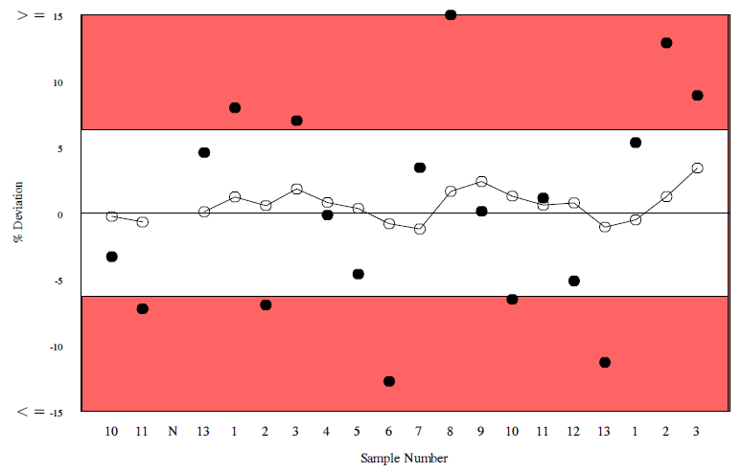

Looking at this % Deviation chart, you can see the results are erratic and are both above and below the 0 deviation line. If however you look at the RM%DEV, you can see it is quite low (TDPA = 6.3).

Slide 96
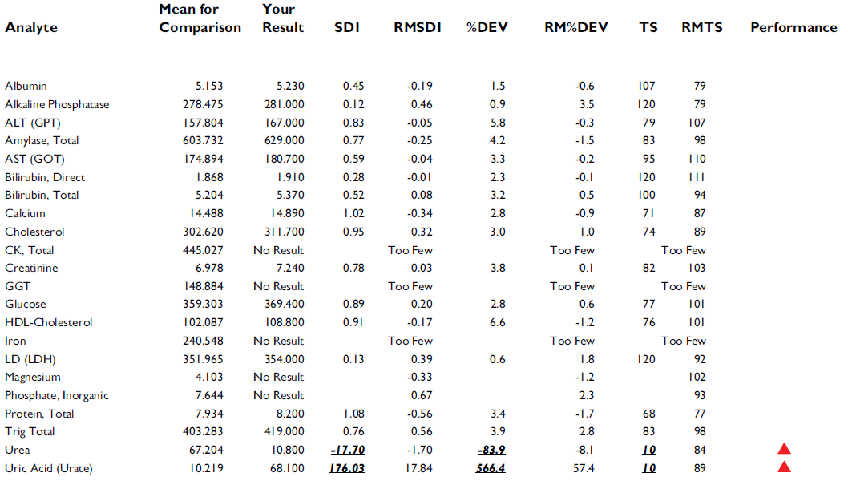
What is wrong with this report?
We can see 2 analytes have been flagged for failing all 3 performance indicators

Slide 97
If you look at the results for Urea and Uric Acid you can see the results have been entered under the wrong parameter.

Slide 98
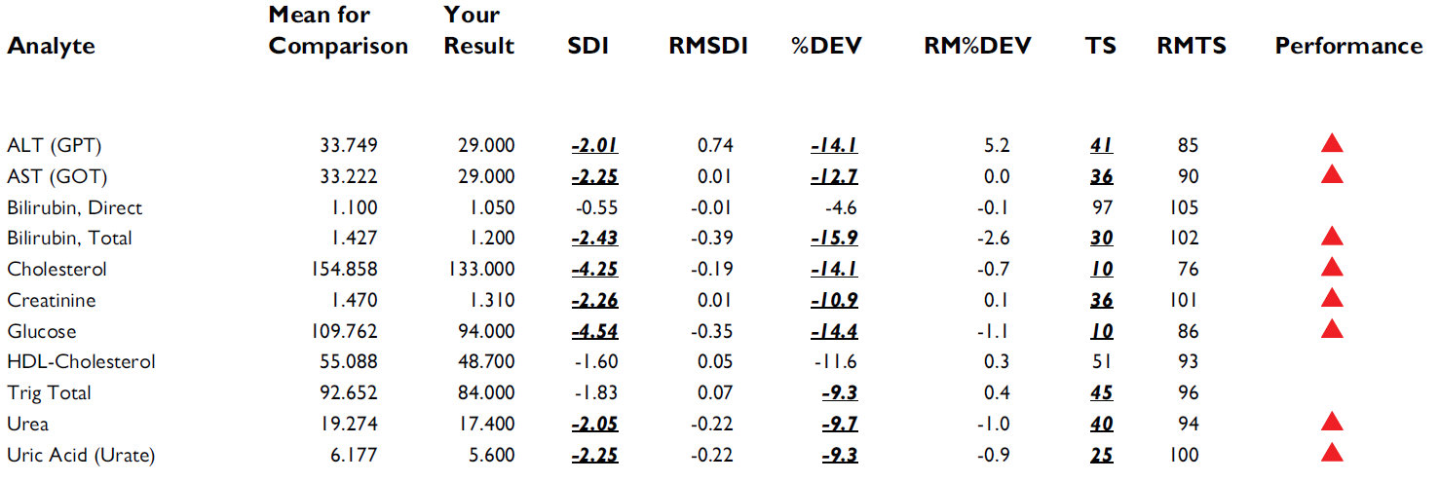
What is wrong with this sample?

Slide 99
When all/almost all parameters are flagged we can tell there is an issue with the sample.
The issue is likely to be the wrong sample has been run or there has been a reconstitution error

Slide 100
We can tell the difference by looking at the % deviations. If they are similar as in this case we know it is a reconstitution error.

Slide 101
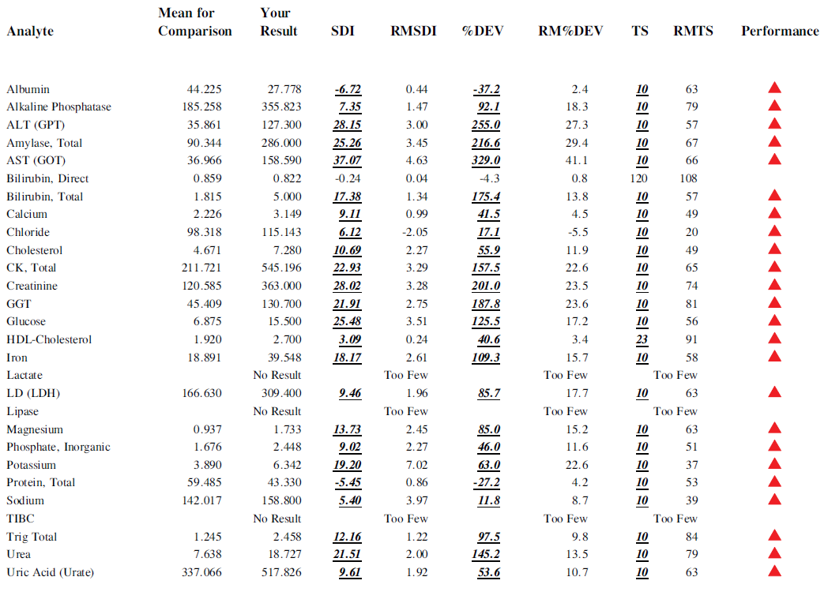
However in this case, when you see such variation in the % deviation, you can tell the wrong sample has been run.

Slide 102
Report Interpretation
Identifying problems on charts

Slide 103
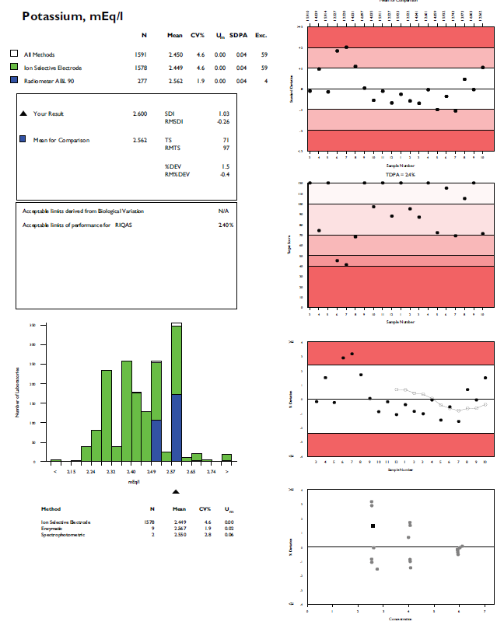

Slide 104
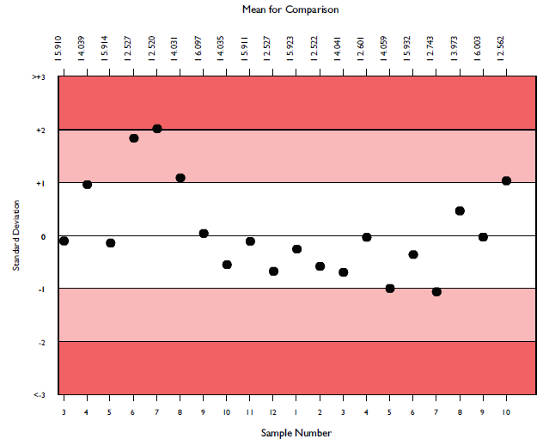
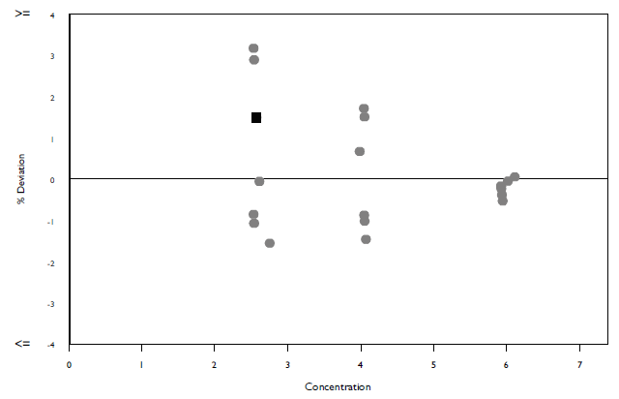
If we look more closely at the charts we can see while there is no clear pattern on the Levey-Jennings, on the % deviation by concentration you can see there is a wider spread in the results at the lower concentrations.

Slide 105
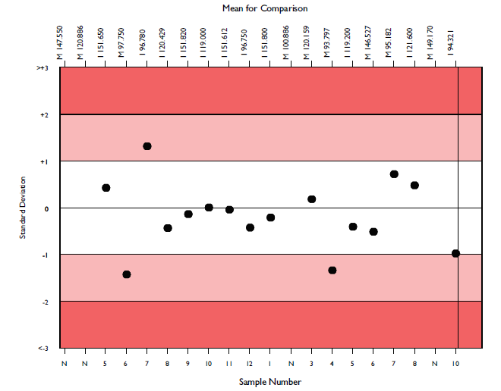
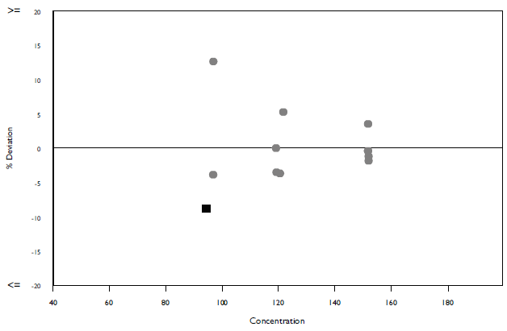
While all performance on Levey-Jennings chart are within acceptable limits, again on the % deviation by concentration chart we can see the deviation is wider at the lower concentrations.

Slide 106



When looking at possible trends in the Levey Jennings chart you must remember that this covering various concentration levels so patterns/trends should be interpreted alongside the %Deviation charts
The concentrations are also listed along the top of the LJ chart to help with comparison of performance.

Slide 107

Running Mean % Deviation
See how running mean % Deviation shows a negative bias but the labs results are actually showing a positive bias – due to sample 6 results being ≤-10%
% Deviation can be useful but should always be interpreted carefully looking at the results that make it up (average of % Deviation of last 10 samples).

Slide 108

% deviation chart
This could highlight a systematic error on an instrument – the results are measuring higher at the low concentration and you can see a downward trend in the results as the concentration increases.

Slide 109


Which parameter has better performance?
pO2
Glucose

Slide 110


Which parameter has better performance?
pO2
Glucose

Slide 111
Which parameter has better performance?
pO2
Glucose
If you look at the scale on each chart: for pO2 the scale goes from +30 to -30
for Glucose the scale goes from +8 to -8.

Slide 112
Report Interpretation
Each EQA report should be evaluated and any poor performance investigated.
  Investigate the source of the problem
  Implement corrective actions
  Check the effectiveness of the corrective actions

Slide 113

Troubleshooting - Establishing a Root Cause
Root Cause Analysis is asking why the problem occurred, and then continuing to ask why that happened until we reach an answer
~ 5 Whys ~
The goal of root cause analysis is to find out:
  What happened?
  Why did it happen?
  How can it be prevented from happening again?
  How do we know we made a difference?
Team Approach involving technicians, Quality Manager, Laboratory Director

Slide 114

Reasons for Failures
2.Steindel SJ, Howanitz PJ, Renner SW. Reasons for proficiency testing failures in clinical chemistry and blood gas analysis. Arch Pathol Lab Med 1996;120:1094–101.
3. Hoeltge GA, Duckworth JK. Review of proficiency testing performance of laboratories accredited by the College of American Pathologists. Arch Pathol Lab Med 1987;111:1011–4.
4. Klee GG, Forsman RW. A user’s classification of problems identified by proficiency testing surveys. Arch Pathol Lab Med 1988; 112:371–3.

Slide 115


Slide 116


Slide 117
When troubleshooting we want to establish the following:
  Is the issue just me?
  Is the issue just for this sample?
  Is the issue the same for others using my instrument/reagent?
  If it is just me:
    Do I see the same issue with my IQC?
    When was the test last calibrated?
    Have any changes been made to the instrument/reagents?
    Is any maintenance due/overdue?

Slide 118
Analysis of IQC data:
When analysing IQC data, it is important to gather the correct information
How often are IQC run and at what concentrations
Who is the supplier of the IQC?
How are the targets set
  Running or Fixed?
How wide are the IQC ranges compared to EQA?

Slide 119
Analysis of IQC data:
How do I use the IQC data?
Always compare “like for like”.
The easiest way to do this is to convert all the IQC
data to a % for comparison purposes.

Slide 120

“My IQC is perfect, but I have a constant negative bias on RIQAS” (Chemistry – Sodium)

Slide 121
IQC Information
 | Level 1 |  | Level 2
Mean | 141 |  | 156
1SD Range | 137 - 145 |  | 151 - 161
Day 1 | 139.5 |  | 154.5
Day 2 | 138.9 |  | 154.1
Day 3 | 139.8 |  | 154.6
Day 4 | 140.2 |  | 155.1
Day 5 | 139.5 |  | 154.2
Day 6 | 138.8 |  | 154.6
Day 7 | 138.6 |  | 153.5
Day 8 | 138.9 |  | 153.8
Day 9 | 138.4 |  | 153.1
Day 10 | 138.1 |  | 153.1
Day 11 | 139.4 |  | 154.2
Day 12 | 138.3 |  | 153.5
Day 13 | 138.3 |  | 153.3
Day 14 | 138.7 |  | 153.4
Day 15 | 138.8 |  | 153.7
Day 16 | 138.4 |  | 153.2
Day 17 | 138.1 |  | 152.9
Day 18 | 138.6 |  | 152.9
Day 19 | 137.6 |  | 152.6
Day 20 | 138.1 |  | 153.1
Mean | 138.75 |  | 153.67
SD | 0.65 |  | 0.68
Lab provided previous 6 months raw results
Target was used from insert sheet
Mean was very close to the target and CV of results was <0.5%
No result EVER outside the 1SD acceptable range

Slide 122
IQC Information
 | Level 1 |  | Level 2
Mean | 141 |  | 156
1SD Range | 137 - 145 |  | 151 - 161
Day 1 | 139.5 |  | 154.5
Day 2 | 138.9 |  | 154.1
Day 3 | 139.8 |  | 154.6
Day 4 | 140.2 |  | 155.1
Day 5 | 139.5 |  | 154.2
Day 6 | 138.8 |  | 154.6
Day 7 | 138.6 |  | 153.5
Day 8 | 138.9 |  | 153.8
Day 9 | 138.4 |  | 153.1
Day 10 | 138.1 |  | 153.1
Day 11 | 139.4 |  | 154.2
Day 12 | 138.3 |  | 153.5
Day 13 | 138.3 |  | 153.3
Day 14 | 138.7 |  | 153.4
Day 15 | 138.8 |  | 153.7
Day 16 | 138.4 |  | 153.2
Day 17 | 138.1 |  | 152.9
Day 18 | 138.6 |  | 152.9
Day 19 | 137.6 |  | 152.6
Day 20 | 138.1 |  | 153.1
Mean | 138.75 |  | 153.67
SD | 0.65 |  | 0.68
Convert the raw results to a % deviation from the target
Level 1
Average % = -1.60%
Level 2
Average % = -1.49%

Slide 123
Then compare the IQC results to the RIQAS % deviations
Level 1 -1.60%
Level 2 -1.49%

Slide 124
Outcome of Performance query:
The participant’s IQC results showed the same deviation from the Mean for Comparison as their RIQAS results.
The larger IQC acceptable range gave a false perception of accuracy and precision.

Slide 125


TOTAL PROTEIN PERFROMANCE ISSUE
Protein, Total on Human Urine Programme
Protein, Total on CSF
Lab were querying why performance was OK for CSF but poor on Human Urine

Slide 126

CFAS calibrator shows different calibrator values for Protein in Urine and CSF.
The lab was using the same calibration for the different matrices.

Slide 127

Lab were advised to calibrate each test separately – here is the performance on the next sample.

Slide 128
Classification
Registering assay details correctly

Slide 129



please look at this Beckman kit insert

Slide 130
Which method code would you put this AST kit under?
Beckman IFCC Ref. with P5P
Beckman mod. IFCC Ref. without P5P
Beckman (extinction coefficient)
Colorimetric
Tris buffer without P5P

Slide 131



Slide 132
Which method code would you put this AST kit under?
Beckman IFCC Ref. with P5P
Beckman mod. IFCC Ref. without P5P
Beckman (extinction coefficient)
Colorimetric
Tris buffer without P5P

Slide 133
Nowhere does it mention P5P (pridoxal-5’-phosphate)

Slide 134
Which method code would you put this AST kit under?
Beckman IFCC Ref. with P5P
Beckman mod. IFCC Ref. without P5P
Beckman (extinction coefficient)
Colorimetric
Tris buffer without P5P

Slide 135


Beckman do however have other kits that do use P5P

Slide 136

For some labs (mainly South America) there is a different calibrator traceability

Slide 137
Which method code would you put this AST kit under?
Beckman IFCC Ref. with P5P
Beckman mod. IFCC Ref. without P5P
Beckman (extinction coefficient)
Colorimetric
Tris buffer without P5P

Slide 138


ACN – Application Code Number

Slide 139
Roche Cholesterol
Same kit – different application

Slide 140


Under the calibrator section it states the test is standardised by one of the methods and according to the other. In this case you need to see the calibrator value sheet to establish which method group should be selected.

Slide 141



You can see here this is also the case for the Beckman IFU.
In this case you have to look at the calibrator insert to find the standardisation.

Slide 142



Slide 143
Future pilots/programmes

Slide 144
Proposed pilot studies
Neonatal Bilirubin
Serology (HIV/Hepatitis)
  HIV Parameters: Anti HBs, HBe Ag, Anti HBs, Anti HBc IgM, Anti HAV, HAV IgM and P24.
Serology (ToRCH)
  TORCH Parameters: Mumps IgG, Measles IgG and Varicella-Zoster.
Serum Indices
G6PDH
Blood Typing

Slide 145
Proposed pilot studies
Cytokines
Faecal testing – Calprotectin
Pre-eclampsia Markers
AMH
Tumour Markers
Autoimmune Antibodies

